Slide 1
Chapter 1: Introduction
Our goal:
get “feel” and terminology
more depth, detail
later in course
approach:
use Internet as
example
Overview:
what’s the Internet?
what’s a protocol?
network edge; hosts, access net, physical media
network core: packet/circuit
switching, Internet structure
performance: loss, delay, throughput
security
protocol layers, service models
history
CuuDuongThanCong.com
https://fb.com/tailieudientucn^{I}tt ^{ntroduction}
1-8

Slide 2
Chapter 1: roadmap
What is the Internet?
Network edge
end systems, access networks, links
Network core
circuit switching, packet switching, network structure
Delay, loss and throughput in packet-switched
networks
Protocol layers, service models
Networks under attack: security
History
https://fb.com/tailieudientucn^{I}tt ^{ntroduction}
CuuDuongThanCong.com

Slide 3









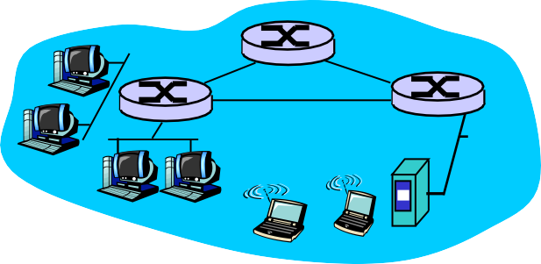


What’s the Internet: “nuts and bolts” view
PC
server
millions of connected computing devices: hosts = end systems
running network
Mobile network
Global ISP
wireless
laptop
cellular
apps
Home network
handheld
communication links
Regional ISP
access
fiber, copper, radio, satellite
transmission
points
Institutional network
wired
links
rate = bandwidth
routers: forward
router
packets (chunks of data)
https://fb.com/tailieudientucn^{I}tt ^{ntroduction}
CuuDuongThanCong.com

Slide 4


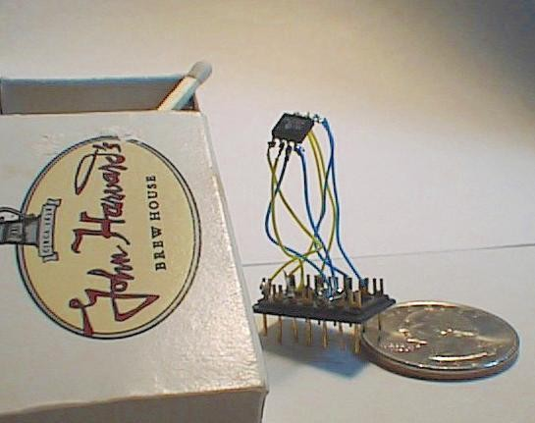

“Cool” internet appliances
Web-enabled toaster +
weather forecaster
IP picture frame http://www.ceiva.com/
World’s smallest web server
http://www-ccs.cs.umass.edu/~shri/iPic.html
Internet phones
https://fb.com/tailieudientucn^{I}tt ^{ntroduction}
CuuDuongThanCong.com

Slide 5
What’s the Internet: “nuts and bolts” view
protocols control sending, receiving of msgs
e.g., TCP, IP, HTTP, Skype,
Ethernet
Internet: “network of networks”
loosely hierarchical
public Internet versus private intranet
Internet standards
RFC: Request for comments
IETF: Internet Engineering Task Force
Mobile network
Global ISP
Home network
Regional ISP
Institutional network
https://fb.com/tailieudientucn^{I}tt ^{ntroduction}
CuuDuongThanCong.com

Slide 6
What’s the Internet: a service view
communication infrastructure enables distributed applications:
Web, VoIP, email, games,
e-commerce, file sharing
communication services provided to apps:
reliable data delivery from source to destination
“best effort” (unreliable) data delivery
https://fb.com/tailieudientucn^{I}tt ^{ntroduction}
CuuDuongThanCong.com

Slide 7
What’s a protocol?
human protocols:
“what’s the time?”
“I have a question”
introductions
… specific msgs sent
… specific actions taken when msgs received, or other events
network protocols:
machines rather than humans
all communication activity in Internet governed by protocols
protocols define format, order of msgs sent and received among network
entities, and actions taken on msg transmission, receipt
https://fb.com/tailieudientucn^{I}tt ^{ntroduction}
CuuDuongThanCong.com

Slide 8



What’s a protocol?
a human protocol and a computer network protocol:
Hi
Hi
TCP connection request
TCP connection
Got the
response
time?
2:00
Get http://www.awl.com/kurose-ross
<file>
time
Q: Other human protocols?
https://fb.com/tailieudientucn^{I}tt ^{ntroduction}
CuuDuongThanCong.com

Slide 9
Chapter 1: roadmap
What is the Internet?
Network edge
end systems, access networks, links
Network core
circuit switching, packet switching, network structure
Delay, loss and throughput in packet-switched
networks
Protocol layers, service models
Networks under attack: security
History
https://fb.com/tailieudientucn^{I}tt ^{ntroduction}
CuuDuongThanCong.com

Slide 10







A closer look at network structure:
network edge:
applications and hosts
access networks, physical media:
wired, wireless communication links
network core:
interconnected routers
network of networks
CuuDuongThanCong.com
https://fb.com/tailieudientucntt
Introduction
1-17

Slide 11




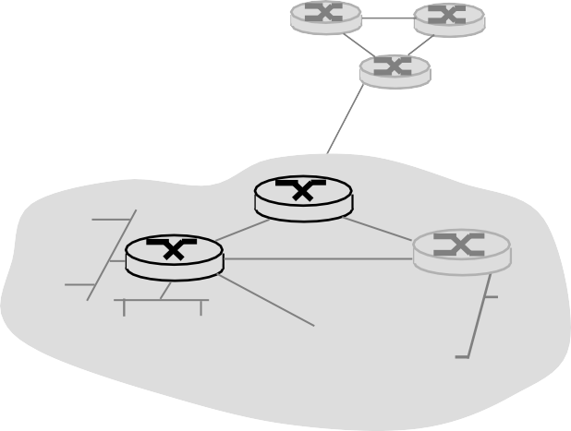



The network edge:
end systems (hosts):
run application programs
e.g. Web, email
at “edge of network”
client/server model
peer-peer
client host requests, receives service from always-on server
e.g. Web browser/server;
client/server
email client/server
peer-peer model:
minimal (or no) use of dedicated servers
e.g. Skype, BitTorrent
https://fb.com/tailieudientucn^{I}tt ^{ntroduction}
CuuDuongThanCong.com

Slide 12
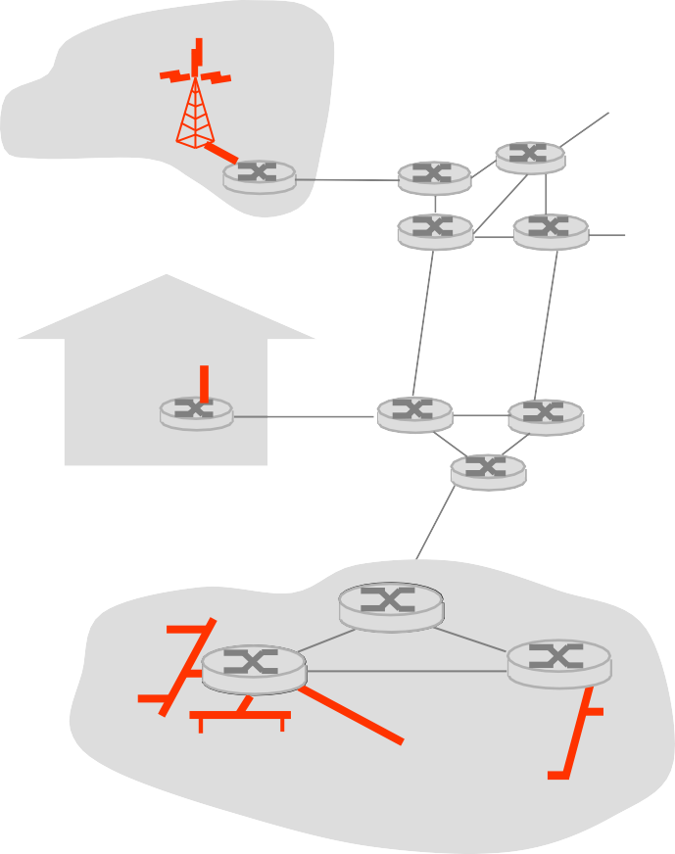








Access networks and physical media
Q: How to connect end systems to edge router?
residential access nets
institutional access networks (school, company)
mobile access networks
Keep in mind:
bandwidth (bits per second) of access network?
shared or dedicated?
https://fb.com/tailieudientucn^{I}tt ^{ntroduction}
CuuDuongThanCong.com

Slide 13




Dial-up Modem
central
office
telephone network
Internet
home PC
home dial-up modem
ISP
modem (e.g., AOL)
Uses existing telephony infrastructure
Home is connected to central office
up to 56Kbps direct access to router (often less)
Can’t surf and phone at same time: not “always on”
CuuDuongThanCong.com
https://fb.com/tailieudientucntt

Slide 14
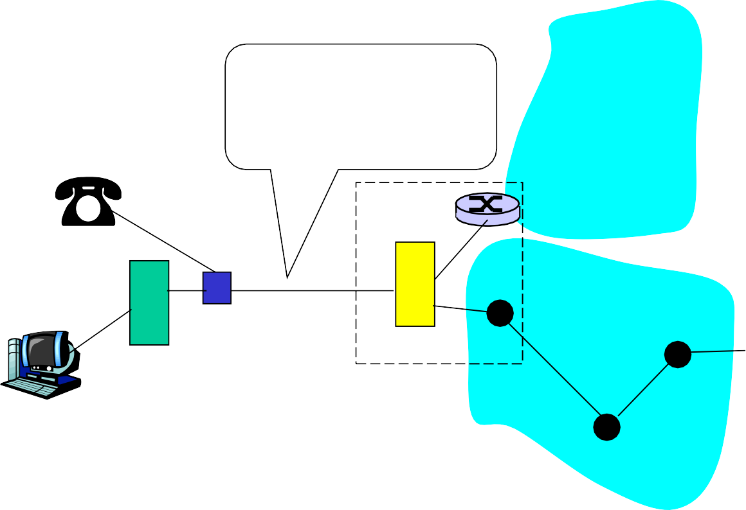
Digital Subscriber Line (DSL)
Existing phone line:
0-4KHz phone; 4-50KHz upstream data; 50KHz-1MHz downstream data
Internet
home phone
DSLAM
telephone network
splitter
DSL
modem
central office
home PC
Also uses existing telephone infrastruture
up to 1 Mbps upstream (today typically < 256 kbps)
up to 8 Mbps downstream (today typically < 1 Mbps)
dedicated physical line to telephone central office
CuuDuongThanCong.com
https://fb.com/tailieudientucntt

Slide 15
Residential access: cable modems
Does not use telephone infrastructure
Instead uses cable TV infrastructure
HFC: hybrid fiber coax
asymmetric: up to 30Mbps downstream, 2 Mbps upstream
network of cable and fiber attaches homes to ISP router
homes share access to router
unlike DSL, which has dedicated access
CuuDuongThanCong.com
https://fb.com/tailieudientucn^{I}tt ^{ntroduction}
1-22

Slide 16
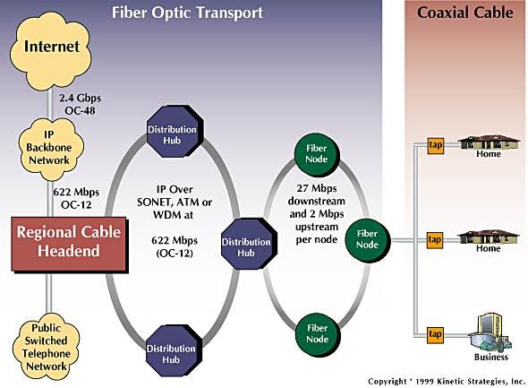
Residential access: cable modems
Diagram: http://www.cabledatacomnews.com/cmic/diagram.html
Introduction
1-23
CuuDuongThanCong.com
https://fb.com/tailieudientucntt

Slide 17

Cable Network Architecture: Overview
Typically 500 to 5,000 homes
cable headend
cable distribution
network (simplified)
home
https://fb.com/tailieudientucn^{I}tt ^{ntroduction}
CuuDuongThanCong.com

Slide 18
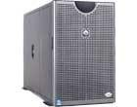

Cable Network Architecture: Overview
server(s)
cable headend
cable distribution
network
home
https://fb.com/tailieudientucn^{I}tt ^{ntroduction}
CuuDuongThanCong.com

Slide 19
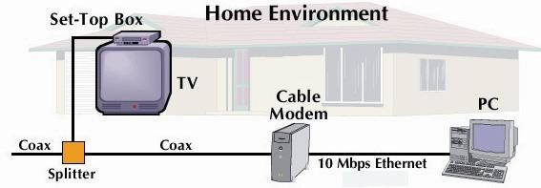

Cable Network Architecture: Overview
cable headend
cable distribution
network (simplified)
home
https://fb.com/tailieudientucn^{I}tt ^{ntroduction}
CuuDuongThanCong.com

Slide 20



Cable Network Architecture: Overview
FDM (more shortly):
 |  |  |  |  |  |  |  | C
 |  |  |  |  |  |  |  | O
V | V | V | V | V | V |  |  | N
I | I | I | I | I | I | D | D | T
D | D | D | D | D | D | A | A | R
E | E | E | E | E | E | T | T | O
O | O | O | O | O | O | A | A | L
1 | 2 | 3 | 4 | 5 | 6 | 7 | 8 | 9
Channels
cable headend
cable distribution
network
home
https://fb.com/tailieudientucn^{I}tt ^{ntroduction}
CuuDuongThanCong.com

Slide 21
Fiber to the Home
ONT
Internet
optical fibers
ONT
optical
OLT
fiber
optical splitter
central office
ONT
Optical links from central office to the home
Two competing optical technologies:
Passive Optical network (PON)
Active Optical Network (PAN)
Much higher Internet rates; fiber also carries television and phone services
CuuDuongThanCong.com
https://fb.com/tailieudientucntt

Slide 22




Ethernet Internet access
100 Mbps
Institutional
router
Ethernet
switch
To Institution’s
ISP
100 Mbps
1 Gbps
100 Mbps
server
Typically used in companies, universities, etc
10 Mbs, 100Mbps, 1Gbps, 10Gbps Ethernet
Today, end systems typically connect into Ethernet switch
CuuDuongThanCong.com
https://fb.com/tailieudientucntt

Slide 23






Wireless access networks
shared wireless access network connects end system to router
via base station aka “access
point”
router
base
wireless LANs:
802.11b/g (WiFi): 11 or 54 Mbps
wider-area wireless access
provided by telco operator
~1Mbps over cellular system (EVDO, HSDPA)
next up (?): WiMAX (10’s Mbps)
over wide area
station
mobile hosts
https://fb.com/tailieudientucn^{I}tt ^{ntroduction}
CuuDuongThanCong.com

Slide 24
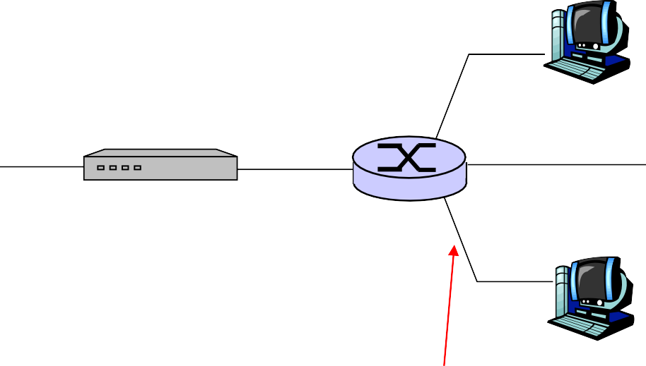



Home networks
Typical home network components:
DSL or cable modem
router/firewall/NAT
Ethernet
wireless access point
wireless
laptops
to/from cable headend
cable modem
router/
firewall
wireless access point
Ethernet
https://fb.com/tailieudientucn^{I}tt ^{ntroduction}
CuuDuongThanCong.com

Slide 25
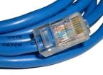
Physical Media
Twisted Pair (TP)
two insulated copper wires
Category 3: traditional phone wires, 10 Mbps Ethernet
Category 5: 100Mbps Ethernet
Bit: propagates between transmitter/rcvr pairs
physical link: what lies between transmitter & receiver
guided media:
signals propagate in solid media: copper, fiber, coax
unguided media:
signals propagate freely,
e.g., radio
https://fb.com/tailieudientucn^{I}tt ^{ntroduction}
CuuDuongThanCong.com

Slide 26

Physical Media: coax, fiber
Fiber optic cable:
glass fiber carrying light pulses, each pulse a bit
high-speed operation:
high-speed point-to-point transmission (e.g., 10’s- 100’s Gps)
low error rate: repeaters spaced far apart ; immune to electromagnetic noise
Coaxial cable:
two concentric copper conductors
bidirectional
baseband:
single channel on cable
legacy Ethernet
broadband:
multiple channels on cable
HFC
https://fb.com/tailieudientucn^{I}tt ^{ntroduction}
CuuDuongThanCong.com

Slide 27
Physical media: radio
Radio link types:
terrestrial microwave
e.g. up to 45 Mbps channels
LAN (e.g., Wifi)
11Mbps, 54 Mbps
wide-area (e.g., cellular)
3G cellular: ~ 1 Mbps
satellite
Kbps to 45Mbps channel (or multiple smaller channels)
270 msec end-end delay
geosynchronous versus low
altitude
signal carried in electromagnetic spectrum
no physical “wire”
bidirectional
propagation environment effects:
reflection
obstruction by objects
interference
https://fb.com/tailieudientucn^{I}tt ^{ntroduction}
CuuDuongThanCong.com

Slide 28
Chapter 1: roadmap
What is the Internet?
Network edge
end systems, access networks, links
Network core
circuit switching, packet switching, network structure
Delay, loss and throughput in packet-switched
networks
Protocol layers, service models
Networks under attack: security
History
https://fb.com/tailieudientucn^{I}tt ^{ntroduction}
CuuDuongThanCong.com

Slide 29





The Network Core
mesh of interconnected routers
the fundamental question: how is data transferred through net?
circuit switching: dedicated circuit per call: telephone net
packet-switching: data sent thru net in
discrete “chunks”
https://fb.com/tailieudientucn^{I}tt ^{ntroduction}
CuuDuongThanCong.com

Slide 30
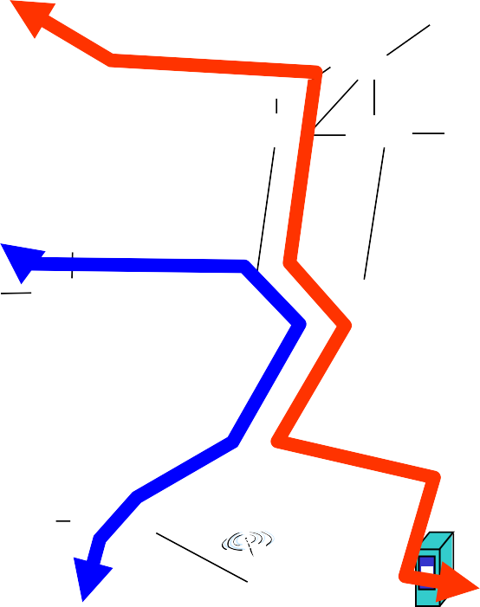
Network Core: Circuit Switching
End-end resources reserved for “call”
link bandwidth, switch capacity
dedicated resources: no sharing
circuit-like (guaranteed) performance
call setup required
https://fb.com/tailieudientucn^{I}tt ^{ntroduction}
CuuDuongThanCong.com

Slide 31
Network Core: Circuit Switching
network resources (e.g., bandwidth) divided into “pieces”
pieces allocated to calls
resource piece idle if not used by owning call (no sharing)
dividing link bandwidth into “pieces”
frequency division
time division
https://fb.com/tailieudientucn^{I}tt ^{ntroduction}
CuuDuongThanCong.com

Slide 32
Circuit Switching: FDM and TDM
Example:
FDM
4 users
frequency
time
TDM
frequency
time
CuuDuongThanCong.com
https://fb.com/tailieudientucn^{I}tt ^{ntroduction}
1-39

Slide 33
Numerical example
How long does it take to send a file of 640,000 bits from host A to host B over a circuit-switched network?
All links are 1.536 Mbps
Each link uses TDM with 24 slots/sec
500 msec to establish end-to-end circuit
Let’s work it out!
https://fb.com/tailieudientucn^{I}tt ^{ntroduction}
CuuDuongThanCong.com

Slide 34
Network Core: Packet Switching
each end-end data stream divided into packets
user A, B packets share
network resources
each packet uses full link bandwidth
resources used as needed
Bandwidth division into “pieces” Dedicated allocation Resource reservation
resource contention:
aggregate resource demand can exceed amount available
congestion: packets queue, wait for link use
store and forward: packets move one hop at a time
Node receives complete
packet before forwarding
https://fb.com/tailieudientucn^{I}tt ^{ntroduction}
CuuDuongThanCong.com

Slide 35


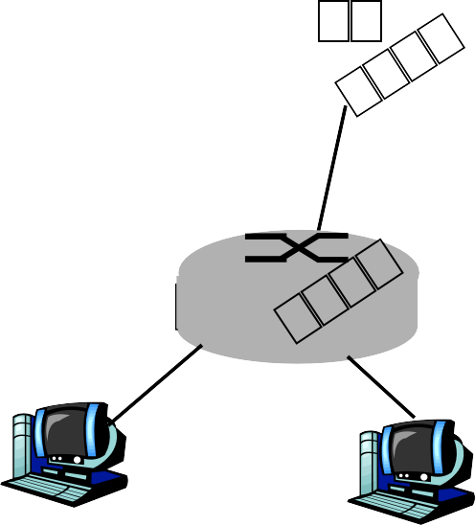
Packet Switching: Statistical Multiplexing
100 Mb/s
A
C
Ethernet
statistical multiplexing
1.5 Mb/s
B
queue of packets waiting for output link
D
E
Sequence of A & B packets does not have fixed pattern, bandwidth shared on demand ➔ statistical multiplexing.
TDM: each host gets same slot in revolving TDM frame.
https://fb.com/tailieudientucn^{I}tt ^{ntroduction}
CuuDuongThanCong.com

Slide 36

Packet-switching: store-and-forward
L
R
takes L/R seconds to transmit (push out) packet of L bits on to link at R bps
store and forward:
R
R
Example:
L = 7.5 Mbits
R = 1.5 Mbps
transmission delay = 15 sec
entire packet must arrive at router before it can be transmitted on next link
delay = 3L/R (assuming zero propagation delay)
more on delay shortly …
https://fb.com/tailieudientucn^{I}tt ^{ntroduction}
CuuDuongThanCong.com

Slide 37


Packet switching versus circuit switching
Packet switching allows more users to use network!
1 Mb/s link
each user:
100 kb/s when “active”
active 10% of time
N users
circuit-switching:
10 users
packet switching:
with 35 users, probability > 10 active at same time is less than .0004
1 Mbps link
Q: how did we get value 0.0004?
https://fb.com/tailieudientucn^{I}tt ^{ntroduction}
CuuDuongThanCong.com

Slide 38
Packet switching versus circuit switching
Is packet switching a “slam dunk winner?”
great for bursty data
resource sharing
simpler, no call setup
excessive congestion: packet delay and loss
protocols needed for reliable data transfer,
congestion control
Q: How to provide circuit-like behavior?
bandwidth guarantees needed for audio/video apps
still an unsolved problem (chapter 7)
Q: human analogies of reserved resources (circuit
switching) versus on-demand allocation (packet-switching)?
Introduction 1-45
CuuDuongThanCong.com https://fb.com/tailieudientucntt

Slide 39
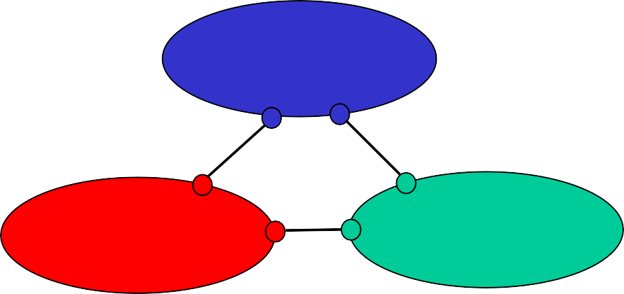
Internet structure: network of networks
roughly hierarchical
at center: “tier-1” ISPs (e.g., Verizon, Sprint, AT&T, Cable and Wireless), national/international coverage
treat each other as equals
Tier-1 providers interconnect (peer) privately
Tier 1 ISP
Tier 1 ISP
Tier 1 ISP
https://fb.com/tailieudientucn^{I}tt ^{ntroduction}
CuuDuongThanCong.com

Slide 40
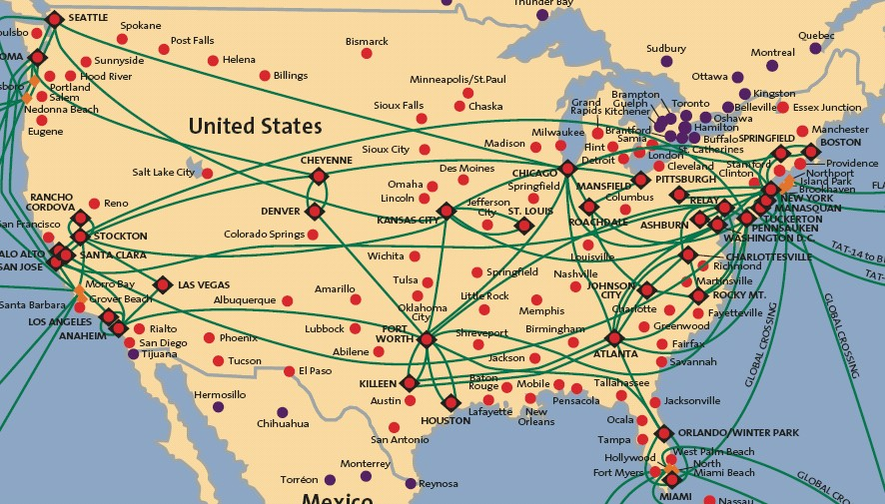

Tier-1 ISP: e.g., Sprint
POP: point-of-presence
to/from backbone
peering
…
…
.
…
…
…
to/from customers
https://fb.com/tailieudientucn^{I}tt ^{ntroduction}
CuuDuongThanCong.com

Slide 41
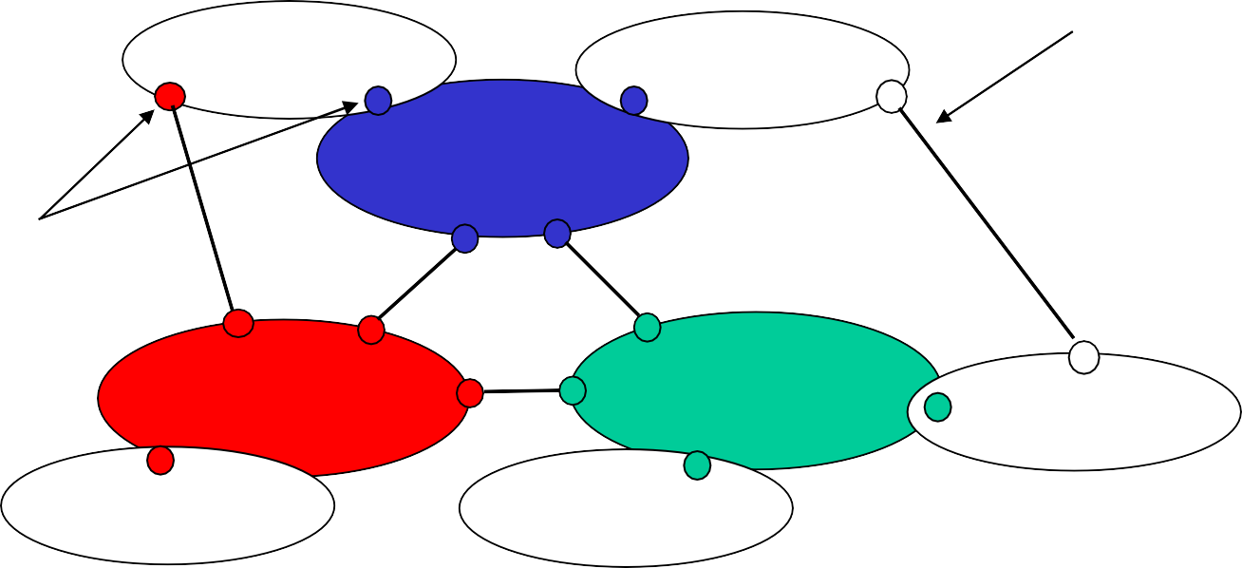
Internet structure: network of networks
“Tier-2” ISPs: smaller (often regional) ISPs
Connect to one or more tier-1 ISPs, possibly other tier-2 ISPs
Tier-2 ISPs also peer privately with each other.
Tier-2 ISP pays tier-1 ISP for connectivity to rest of Internet
tier-2 ISP is customer of tier-1 provider
Tier-2 ISP
Tier-2 ISP
Tier 1 ISP
Tier 1 ISP
Tier-2 ISP
Tier 1 ISP
Tier-2 ISP
Tier-2 ISP
https://fb.com/tailieudientucn^{I}tt ^{ntroduction}
CuuDuongThanCong.com

Slide 42
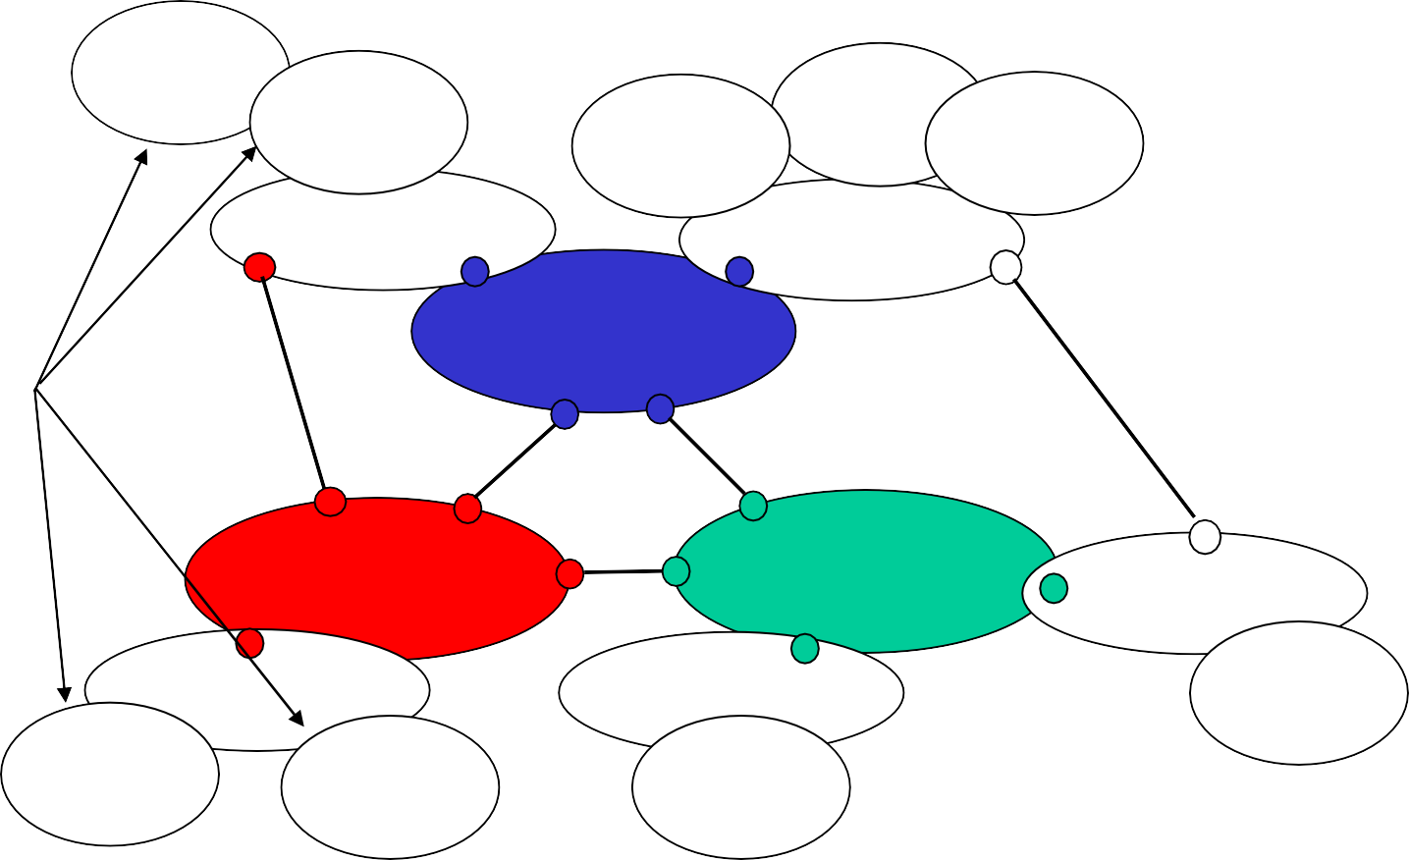
Internet structure: network of networks
“Tier-3” ISPs and local ISPs
last hop (“access”) network (closest to end systems)
local
ISP
Tier 3
ISP
Tier-2 ISP
local
ISP
local ISP
local ISP
Local and tier- 3 ISPs are customers of higher tier ISPs
connecting them to rest of Internet
Tier-2 ISP
Tier 1 ISP
Tier 1 ISP
Tier-2 ISP
local ISP
Tier 1 ISP
Tier-2 ISP local ISP
Tier-2 ISP
local
ISP
local ISP
Introduction
1-49
CuuDuongThanCong.com
https://fb.com/tailieudientucntt

Slide 43
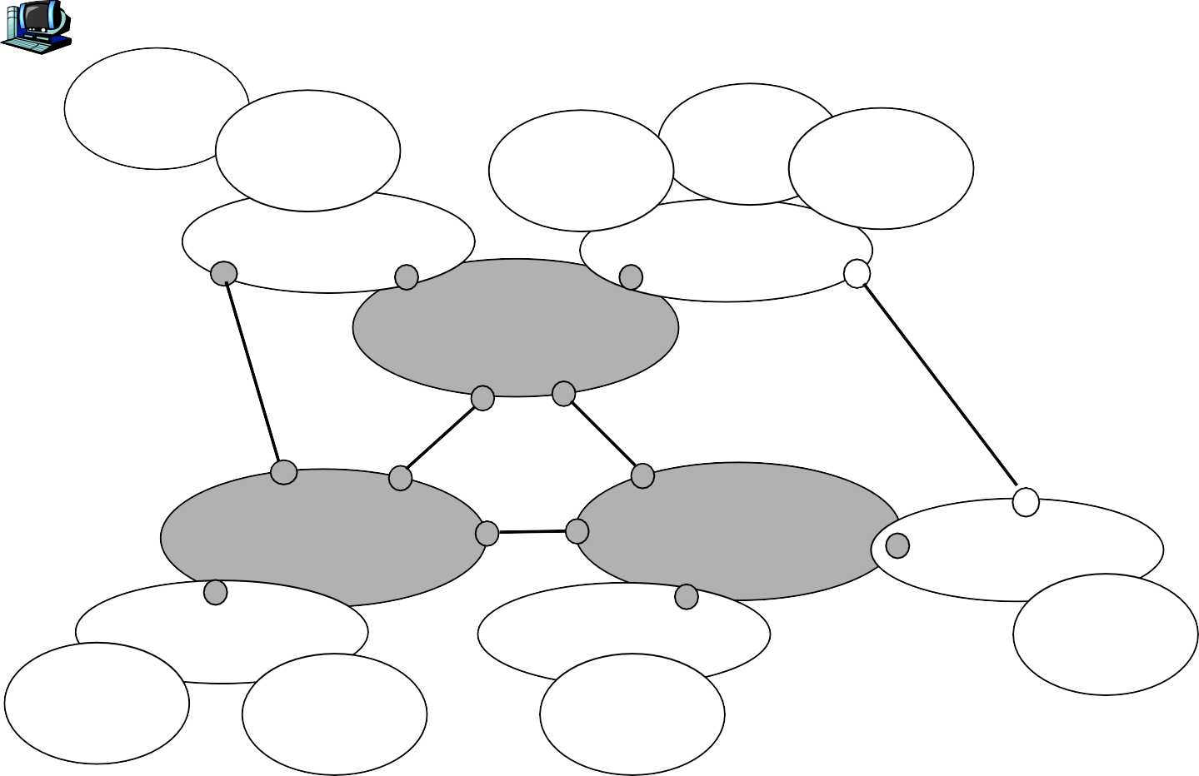

Internet structure: network of networks
a packet passes through many networks!
local
ISP
Tier 3
ISP
Tier-2 ISP
local
ISP
local ISP
local ISP
Tier-2 ISP
Tier 1 ISP
Tier 1 ISP
Tier-2 ISP
local ISP
Tier 1 ISP
Tier-2 ISP local ISP
Tier-2 ISP
local
ISP
local ISP
Introduction
1-50
CuuDuongThanCong.com
https://fb.com/tailieudientucntt

Slide 44
Chapter 1: roadmap
What is the Internet?
Network edge
end systems, access networks, links
Network core
circuit switching, packet switching, network structure
Delay, loss and throughput in packet-switched
networks
Protocol layers, service models
Networks under attack: security
History
CuuDuongThanCong.com
https://fb.com/tailieudientucn^{I}tt ^{ntroduction}
1-51

Slide 45



How do loss and delay occur?
packets queue in router buffers
packet arrival rate to link exceeds output link capacity
packets queue, wait for turn
packet being transmitted (delay)
A
B
packets queueing (delay)
free (available) buffers: arriving packets dropped (loss) if no free buffers
CuuDuongThanCong.com
https://fb.com/tailieudientucntt
Introduction
1-52

Slide 46
Four sources of packet delay
1. nodal processing:
check bit errors
determine output link
2. queueing
time waiting at output link for transmission
depends on congestion level of router
transmission
A
propagation
B
nodal processing
queueing
CuuDuongThanCong.com
https://fb.com/tailieudientucn^{I}tt ^{ntroduction}
1-53

Slide 47

Delay in packet-switched networks
3. Transmission delay:
R=link bandwidth (bps)
L=packet length (bits)
time to send bits into link = L/R
4. Propagation delay:
d = length of physical link
s = propagation speed in medium (~2x10⁸ m/sec)
propagation delay = d/s
Note: s and R are very
different quantities!
transmission
A
propagation
B
nodal processing
queueing
CuuDuongThanCong.com
https://fb.com/tailieudientucntt
Introduction
1-54

Slide 48
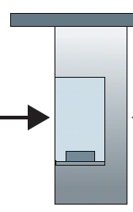



Caravan analogy
100 km 100 km
ten-car caravan
toll booth
toll booth
Time to “push” entire caravan through toll booth onto highway = 12*10 = 120 sec
Time for last car to propagate from 1st to 2nd toll both: 100km/(100km/hr)= 1 hr
A: 62 minutes
cars “propagate” at
100 km/hr
toll booth takes 12 sec to service car (transmission time)
car~bit; caravan ~ packet
Q: How long until caravan is lined up before 2nd toll booth?
https://fb.com/tailieudientucn^{I}tt ^{ntroduction}
CuuDuongThanCong.com

Slide 49
Caravan analogy (more)
100 km 100 km
ten-car caravan
toll booth
toll booth
Yes! After 7 min, 1st car at 2nd booth and 3 cars still at 1st booth.
1st bit of packet can arrive at 2nd router before packet is fully transmitted at 1st router!
See Ethernet applet at AWL Web site
Cars now “propagate” at 1000 km/hr
Toll booth now takes 1 min to service a car
Q: Will cars arrive to 2nd booth before all cars serviced at 1st booth?
https://fb.com/tailieudientucn^{I}tt ^{ntroduction}
CuuDuongThanCong.com

Slide 50
Nodal delay
^{d}nodal ^{= d}proc ^{+ d}queue ^{+ d}trans ^{+ d}prop
d_{proc} = processing delay
typically a few microsecs or less
d_{queue} = queuing delay
depends on congestion
d_{trans} = transmission delay
❖ = L/R, significant for low-speed links
d_{prop} = propagation delay
a few microsecs to hundreds of msecs
https://fb.com/tailieudientucn^{I}tt ^{ntroduction}
CuuDuongThanCong.com

Slide 51
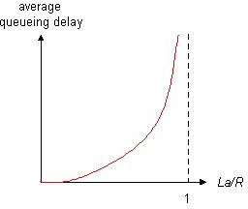
Queueing delay (revisited)
R=link bandwidth (bps)
L=packet length (bits)
a=average packet arrival rate
traffic intensity = La/R
La/R ~ 0: average queueing delay small
La/R -> 1: delays become large
La/R > 1: more “work” arriving than can be serviced, average delay infinite!
https://fb.com/tailieudientucn^{I}tt ^{ntroduction}
CuuDuongThanCong.com

Slide 52
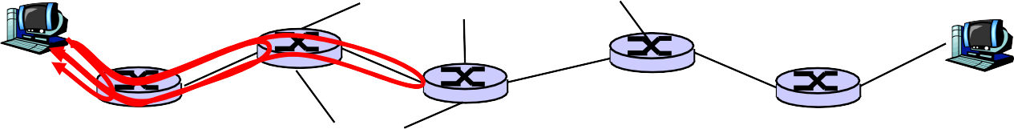
“Real” Internet delays and routes
What do “real” Internet delay & loss look like?
❑
Traceroute
program: provides delay
measurement from source to router along end-end Internet path towards destination. For all i:
sends three packets that will reach router i on path towards destination
router i will return packets to sender
sender times interval between transmission and reply.
3 probes
probes
https://fb.com/tailieudientucn^{I}tt ^{ntroduction}
1-59

Slide 53
“Real” Internet delays and routes
traceroute: gaia.cs.umass.edu to www.eurecom.fr
Three delay measurements from gaia.cs.umass.edu to cs-gw.cs.umass.edu
1 cs-gw (128.119.240.254) 1 ms 1 ms 2 ms
2 border1-rt-fa5-1-0.gw.umass.edu (128.119.3.145) 1 ms 1 ms 2 ms
3 cht-vbns.gw.umass.edu (128.119.3.130) 6 ms 5 ms 5 ms
4 jn1-at1-0-0-19.wor.vbns.net (204.147.132.129) 16 ms 11 ms 13 ms
5 jn1-so7-0-0-0.wae.vbns.net (204.147.136.136) 21 ms 18 ms 18 ms
abilene-vbns.abilene.ucaid.edu (198.32.11.9) 22 ms 18 ms 22 ms
nycm-wash.abilene.ucaid.edu (198.32.8.46) 22 ms 22 ms 22 ms
8 62.40.103.253 (62.40.103.253) 104 ms 109 ms 106 ms
9 de2-1.de1.de.geant.net (62.40.96.129) 109 ms 102 ms 104 ms
10 de.fr1.fr.geant.net (62.40.96.50) 113 ms 121 ms 114 ms
11 renater-gw.fr1.fr.geant.net (62.40.103.54) 112 ms 114 ms 112 ms
12 nio-n2.cssi.renater.fr (193.51.206.13) 111 ms 114 ms 116 ms
13 nice.cssi.renater.fr (195.220.98.102) 123 ms 125 ms 124 ms
trans-oceanic link
14 r3t2-nice.cssi.renater.fr (195.220.98.110) 126 ms 126 ms 124 ms
15 eurecom-valbonne.r3t2.ft.net (193.48.50.54) 135 ms 128 ms 133 ms
16 194.214.211.25 (194.214.211.25) 126 ms 128 ms 126 ms
17 * * *
18 * * *
* means no response (probe lost, router not replying)
19 fantasia.eurecom.fr (193.55.113.142) 132 ms 128 ms 136 ms
https://fb.com/tailieudientucn^{I}tt ^{ntroduction}
CuuDuongThanCong.com

Slide 54
Packet loss
queue (aka buffer) preceding link in buffer has finite capacity
packet arriving to full queue dropped (aka lost)
lost packet may be retransmitted by previous node, by source end system, or not at all
buffer
(waiting area)
packet being transmitted
A
B
packet arriving to full buffer is lost
https://fb.com/tailieudientucn^{I}tt ^{ntroduction}
CuuDuongThanCong.com

Slide 55



Throughput
throughput: rate (bits/time unit) at which bits transferred between sender/receiver
instantaneous: rate at given point in time
average: rate over longer period of time
server, with file of F bits to send to clien
link capacity R_{s} bits/sec
t
link capacity R_{c} bits/sec
server sends bits
(fluid) into pipe
pipe that can carry fluid at rate
R_{s} bits/sec)
pipe that can carry fluid at rate
R_{c} bits/sec)
https://fb.com/tailieudientucn^{I}tt ^{ntroduction}
CuuDuongThanCong.com

Slide 56






Throughput (more)
R_{s} < R_{c}
What is average end-end throughput?
R_{s} bits/sec
R_{c} bits/sec
R_{s} > R_{c}
What is average end-end throughput?
R_{s} bits/sec
R_{c} bits/sec
bottleneck link
link on end-end path that constrains end-end throughput
https://fb.com/tailieudientucn^{I}tt ^{ntroduction}
CuuDuongThanCong.com

Slide 57






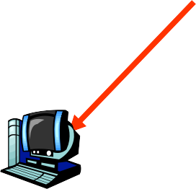



Throughput: Internet scenario
R_{s}
per-connection end-end throughput: min(R_{c},R_{s},R/10)
in practice: R_{c} or R_{s} is often bottleneck
R_{s}
R_{s}
R
R_{c}
R_{c}
R_{c}
10 connections (fairly) share backbone bottleneck link R bits/sec
https://fb.com/tailieudientucn^{I}tt ^{ntroduction}
CuuDuongThanCong.com

Slide 58
Chapter 1: roadmap
What is the Internet?
Network edge
end systems, access networks, links
Network core
circuit switching, packet switching, network structure
Delay, loss and throughput in packet-switched
networks
Protocol layers, service models
Networks under attack: security
History
https://fb.com/tailieudientucn^{I}tt ^{ntroduction}
CuuDuongThanCong.com

Slide 59
Protocol “Layers”
Networks are complex!
many “pieces”:
hosts
routers
links of various media
applications
protocols
hardware, software
Question:
Is there any hope of
organizing structure of network?
Or at least our discussion
of networks?
https://fb.com/tailieudientucn^{I}tt ^{ntroduction}
CuuDuongThanCong.com

Slide 60
Organization of air travel
ticket (purchase)
baggage (check)
gates (load) runway takeoff airplane routing
ticket (complain)
baggage (claim) gates (unload) runway landing airplane routing
airplane routing
a series of steps
https://fb.com/tailieudientucn^{I}tt ^{ntroduction}
CuuDuongThanCong.com

Slide 61

Layering of airline functionality
ticket (purchase)
ticket (complain)
ticket
baggage (check)
baggage (claim
baggage
gates (load)
gates (unload)
gate
runway (takeoff)
runway (land)
takeoff/landing
airplane routing
airplane routing airplane routing
intermediate air-traffic
control centers
airplane routing
airplane routing
departure airport
arrival airport
Layers: each layer implements a service
via its own internal-layer actions
relying on services provided by layer below
https://fb.com/tailieudientucn^{I}tt ^{ntroduction}
CuuDuongThanCong.com

Slide 62
Why layering?
Dealing with complex systems:
explicit structure allows identification, relationship of complex system’s pieces
layered reference model for discussion
modularization eases maintenance, updating of system
change of implementation of layer’s service transparent to rest of system
e.g., change in gate procedure doesn’t affect rest of system
layering considered harmful?
https://fb.com/tailieudientucn^{I}tt ^{ntroduction}
CuuDuongThanCong.com

Slide 63
Internet protocol stack
application: supporting network applications
FTP, SMTP, HTTP
transport: process-process data
transfer
TCP, UDP
network: routing of datagrams from source to destination
IP, routing protocols
link: data transfer between neighboring network elements
PPP, Ethernet
physical: bits “on the wire”
application
transport network link physical
https://fb.com/tailieudientucn^{I}tt ^{ntroduction}
CuuDuongThanCong.com

Slide 64
ISO/OSI reference model
presentation: allow applications to interpret meaning of data, e.g., encryption, compression, machine- specific conventions
session: synchronization, checkpointing, recovery of data exchange
Internet stack “missing” these
layers!
these services, if needed, must be implemented in application
needed?
application presentation session transport network
link physical
https://fb.com/tailieudientucn^{I}tt ^{ntroduction}
CuuDuongThanCong.com

Slide 65







Encapsulation
source
message
M
application
transport
segment
H_{t}
H_{t}
M
datagram
H_{n}
network link
H_{n}
H_{t} M
frame
H_{l}
H_{n} H_{t}
M
physical
link physical
switch
destination
H_{n} | H_{t} | M
network
link
M
application
H_{l} H_{n} H_{t} M
H_{n}
H_{t} M
H_{t}
M
transport
physical
 | H_{n} | H_{t} | M
H_{l} | H_{n} | H_{t} | M
network
link
router
physical
https://fb.com/tailieudientucn^{I}tt ^{ntroduction}
CuuDuongThanCong.com

Slide 66
Chapter 1: roadmap
What is the Internet?
Network edge
end systems, access networks, links
Network core
circuit switching, packet switching, network structure
Delay, loss and throughput in packet-switched
networks
Protocol layers, service models
Networks under attack: security
History
https://fb.com/tailieudientucn^{I}tt ^{ntroduction}
CuuDuongThanCong.com

Slide 67
Network Security
The field of network security is about:
how bad guys can attack computer networks
how we can defend networks against attacks
how to design architectures that are immune to attacks
Internet not originally designed with (much) security in mind
original vision: “a group of mutually trusting users attached to a transparent network” ☺
Internet protocol designers playing “catch-up”
Security considerations in all layers!
https://fb.com/tailieudientucn^{I}tt ^{ntroduction}
CuuDuongThanCong.com

Slide 68
Bad guys can put malware into hosts via Internet
Malware can get in host from a virus, worm, or
trojan horse.
Spyware malware can record keystrokes, web sites visited, upload info to collection site.
Infected host can be enrolled in a botnet, used for spam and DDoS attacks.
Malware is often self-replicating: from an infected host, seeks entry into other hosts
https://fb.com/tailieudientucn^{I}tt ^{ntroduction}
CuuDuongThanCong.com

Slide 69
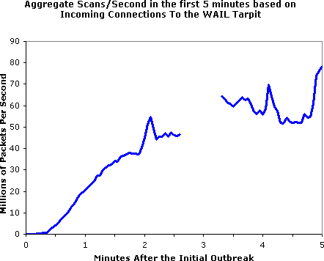
Bad guys can put malware into hosts via Internet
Trojan horse
Hidden part of some otherwise useful software
Today often on a Web page (Active-X, plugin)
Virus
infection by receiving object (e.g., e-mail attachment), actively executing
self-replicating: propagate itself to other hosts, users
Worm:
infection by passively receiving object that gets itself executed
self- replicating: propagates to other hosts, users
Sapphire Worm: aggregate scans/sec
in first 5 minutes of outbreak (CAIDA, UWisc data)
CuuDuongThanCong.com
https://fb.com/tailieudientucntt
Introduction
1-76

Slide 70
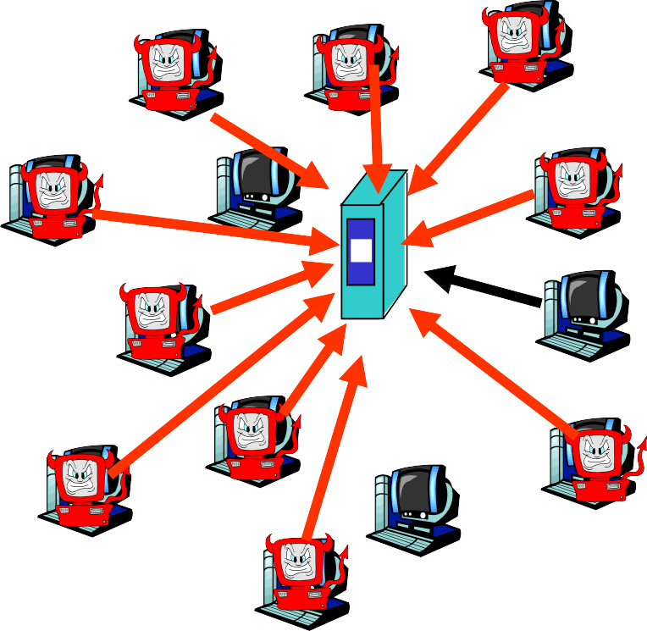
Bad guys can attack servers and network infrastructure
Denial of service (DoS): attackers make resources (server, bandwidth) unavailable to legitimate traffic by overwhelming resource with bogus traffic
select target
break into hosts around the network (see botnet)
send packets toward
target from compromised hosts
target
https://fb.com/tailieudientucn^{I}tt ^{ntroduction}
CuuDuongThanCong.com

Slide 71




The bad guys can sniff packets
Packet sniffing:
broadcast media (shared Ethernet, wireless)
promiscuous network interface reads/records all
packets (e.g., including passwords!) passing by
A
C
src:B dest:A
payload
B
Wireshark software used for end-of-chapter labs is a (free) packet-sniffer
https://fb.com/tailieudientucn^{I}tt ^{ntroduction}
CuuDuongThanCong.com

Slide 72



The bad guys can use false source addresses
IP spoofing: send packet with false source address
A
C
src:B
dest:A
payload
B
https://fb.com/tailieudientucn^{I}tt ^{ntroduction}
CuuDuongThanCong.com

Slide 73
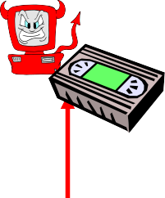



The bad guys can record and playback
record-and-playback: sniff sensitive info (e.g.,
password), and use later
password holder is that user from system point of view
C
A
src:B dest:A
user: B; password: foo
B
https://fb.com/tailieudientucn^{I}tt ^{ntroduction}
CuuDuongThanCong.com

Slide 74
Network Security
more throughout this course
chapter 8: focus on security
crypographic techniques: obvious uses and not so obvious uses
https://fb.com/tailieudientucn^{I}tt ^{ntroduction}
CuuDuongThanCong.com

Slide 75
Chapter 1: roadmap
What is the Internet?
Network edge
end systems, access networks, links
Network core
circuit switching, packet switching, network structure
Delay, loss and throughput in packet-switched
networks
Protocol layers, service models
Networks under attack: security
History
https://fb.com/tailieudientucn^{I}tt ^{ntroduction}
CuuDuongThanCong.com

Slide 76
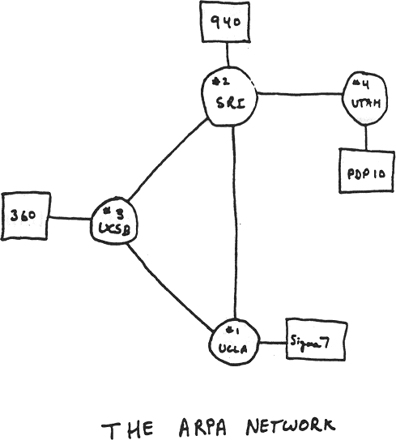
Internet History
1961-1972: Early packet-switching principles
1961: Kleinrock - queueing theory shows effectiveness of packet- switching
1964: Baran - packet- switching in military nets
1967: ARPAnet conceived by Advanced Research Projects Agency
1969: first ARPAnet node operational
1972:
ARPAnet public demonstration
NCP (Network Control Protocol) first host-host protocol
first e-mail program
ARPAnet has 15 nodes
https://fb.com/tailieudientucn^{I}tt ^{ntroduction}
CuuDuongThanCong.com

Slide 77
Internet History
1972-1980: Internetworking, new and proprietary nets
1970: ALOHAnet satellite network in Hawaii
1974: Cerf and Kahn - architecture for interconnecting networks
1976: Ethernet at Xerox PARC
ate70’s: proprietary architectures: DECnet, SNA, XNA
late 70’s: switching fixed length packets (ATM precursor)
1979: ARPAnet has 200 nodes
Cerf and Kahn’s internetworking
principles:
minimalism, autonomy - no internal changes required to interconnect networks
best effort service model
stateless routers
decentralized control define today’s Internet
architecture
https://fb.com/tailieudientucn^{I}tt ^{ntroduction}
CuuDuongThanCong.com

Slide 78
Internet History
1980-1990: new protocols, a proliferation of networks
1983: deployment of TCP/IP
1982: smtp e-mail protocol defined
1983: DNS defined for name-to-IP- address translation
1985: ftp protocol defined
1988: TCP congestion control
new national networks: Csnet, BITnet, NSFnet, Minitel
100,000 hosts connected to confederation of networks
https://fb.com/tailieudientucn^{I}tt ^{ntroduction}
CuuDuongThanCong.com

Slide 79
Internet History
1990, 2000’s: commercialization, the Web, new apps
Early 1990’s: ARPAnet
Late 1990’s – 2000’s:
decommissioned
1991: NSF lifts restrictions on commercial use of NSFnet (decommissioned, 1995)
early 1990s: Web
hypertext [Bush 1945, Nelson 1960’s]
HTML, HTTP: Berners-Lee
1994: Mosaic, later Netscape
late 1990’s:
commercialization of the Web
more killer apps: instant messaging, P2P file sharing
network security to
forefront
est. 50 million host, 100 million+ users
backbone links running at Gbps
https://fb.com/tailieudientucn^{I}tt ^{ntroduction}
CuuDuongThanCong.com

Slide 80
Internet History
2007:
~500 million hosts
Voice, Video over IP
P2P applications: BitTorrent (file sharing) Skype (VoIP), PPLive (video)
more applications: YouTube, gaming
wireless, mobility
https://fb.com/tailieudientucn^{I}tt ^{ntroduction}
CuuDuongThanCong.com

Slide 81
Introduction: Summary
Covered a “ton” of material!
Internet overview
what’s a protocol?
network edge, core, access network
packet-switching versus circuit-switching
Internet structure
performance: loss, delay, throughput
layering, service models
security
history
You now have:
context, overview,
“feel” of networking
more depth, detail to follow!
https://fb.com/tailieudientucn^{I}tt ^{ntroduction}
CuuDuongThanCong.com

